Slide 1
Apps For Mindfulness
& Wellbeing

Slide 2
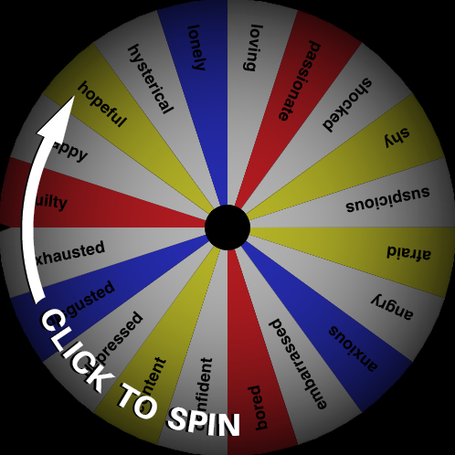
WARM-UP

Slide 3
Benefits of Mindfulness
‘…improve their wellbeing, reduce worries, anxiety, distress, reactivity and bad behaviour, improve sleep, self esteem, and bring about greater calmness, relaxation, and self-regulation and awareness.’

Slide 4
Benefits of Mindfulness
Enhanced focus and less wandering of the mind
Increase in overall positive emotions
Improvement in symptoms of depression and anxiety
Lower levels of fatigue
Reduced aggression and judgment of others; increased compassion
Reduced sense of external pressure
Self-acceptance improves

Slide 5
Benefits of Mindfulness
LESS STRESS!

Slide 6
Breathe, Think, Do

Slide 7
Chill Panda

Slide 8
The Zones of Regulation

Slide 9
Smiling Mind

Slide 10
Mindful Powers

Slide 11
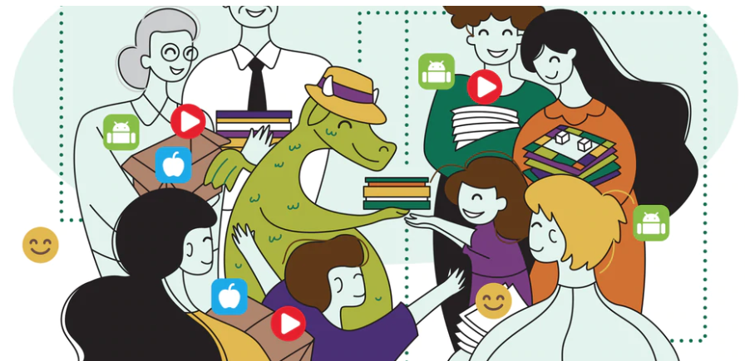
Mindfulness Resources
Iris The Dragon
The Little Blue Book
Of Sunshine
Mentally Healthy
Schools

Slide 12
Mindfull Colouring
Sandbox
Toonia Colorbook

